Slide 1
Appraisal Training
Hyperlink

Slide 2
PRACTISING TEACHER CRITERIA
Have a go? Can we list the PTCs?

Slide 3
Appraisal components
Appraisal Report
Appraisal Discussions
Interpreting evidence
Feedback
Next steps
Affirmation
Overall evaluative judgements/statements
Key strengths
Concerns
Support to be provided
Performance Management
Re-registration (every 3 years)
Attestation (annual for pay progression)
Appraisal (annual for growth and development)
Process:
Criteria established
Goal setting
Indicators of success identified
Timeframes and actions identified
Support to be provided
Evidence Collected
(learning portfolio)
Teaching as Inquiry
Observations /feedback
Evidence of learning(teacher/learner)
Student voice
Informal feedback
Contribution to wider school - feedback from other staff

Slide 4
New Summary Statement
APPRAISER ENDORSEMENT:
After careful reading of and reflection on the appraisal portfolio, discussion of professional practice and observation of teaching.
I am confident that
_________________________________
meets the criteria of the Practising Teacher Criteria ( RTC renamed in 2015)and the Professional Standards (STCA)
Signed:_________________________________ Date:________

Slide 5
Portfolio Checklist
Evidence | Notes | Completed/Comments
Goal setting | Are they stretch ISMART goals?
Exam analysis | Senior classes NCEA Junior classes Westlake Exams
Classroom observation | Reflections from observation?
Student evaluations | Analysis and reflections from the results?
TAI | Evidence for inquiry
 | Strategies are described
 | Evaluation
 | Reflection
Contribution to learning community
Professional Development | Is table linked to Report T drive

Slide 6
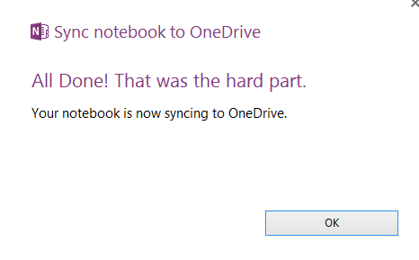
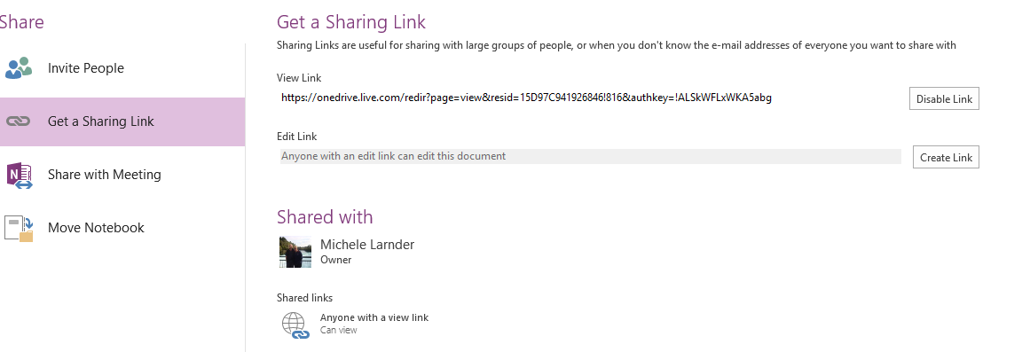
Open note book
Select FILE
How to share your
Portfolio with your appraiser
Select share on web or network
Select
continue
Select OK
Select invite
Select view link, copy link and email to appraiser

Slide 7
Open to learning disposition
It’s about a recognition that we are all learners and learning takes place when there are high levels of:
Trust
Respect
Inquiry
Conversation
Action

Slide 8
1. Say what you think
6. Make a plan
2. Say why you think it
Respect for self and others
Valid Information
Internal commitment to decisions
5. Establish common ground
3. Inquire
Their reactions
Their own thoughts
Accuracy (paraphrase/ check)
4. Detect and check assumptions
Open to learning conversation – components

Slide 9
http://connect.vln.school.nz/olc
Link to Vivanne Robinson lecture on ‘Open conversations”

Slide 10
SENARIOS
1 Goal setting : appraisee has not set herself/himself ‘stretch ISMART goals’, they don’t relate to the schools strategic goals, they are not measureable and will not result in professional growth
2 You have observed a lesson that is 90% teacher talk
3 You have observed a lesson in which there appears to be little connection between the teacher and his/her students
4 The evidence of the TAI is very limited
5 After looking at the portfolio you are not prepared to sign
6 Exam analysis from the previous year shows the teachers results are below the expected level of achievement
7 ?????????

